Slide 1
Graph Design
For Effective Communication

Slide 3
We live in the so-called information age.
We have far more data than we’ve ever had, but our ability to make good use of it hasn’t caught up.
Information is useless until we understand what it means and can clearly communicate that meaning to those who need it

Slide 4
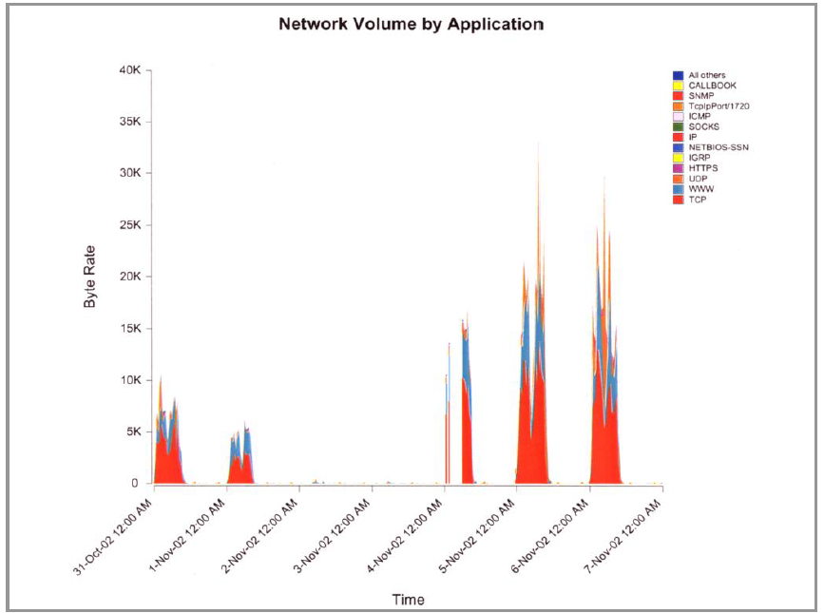
This graph was just presented in class by your professor:
You stare at this graph very intently, but with increasing agitation as you try to keep any hint of confusion from crossing your face. From your peripheral vision you can see that the others in the room are smiling and nodding with apparent understanding and approval. You feel very dumb. What you don’t realize is that you are not alone. No one can make sense of this graph.

Slide 5
Quantitative data
measure the health of our organizations, to identify opportunities, and to anticipate the future.
Despite great progress in our ability to gather and warehouse data, we’re still missing the boat if we don’t communicate the numbers effectively. Contrary to popular wisdom, information cannot always speak for itself.

Slide 6
Few people are trained.
Few people recognize the need.
Few examples of good design exist to expose the problem.
―Poor documents are so commonplace that deciphering bad writing and bad visual design have become part of the coping skills needed to navigate in the so-called information age.

Slide 7
Can you make sense of this?!!!
In the two centuries since [the invention of the first graphs], …charts have become commonplace.
Creating graphs has probably become too easy. Graphs are often produced without thought for their main purpose: to enlighten and inform the reader

Slide 8
The purpose of this graph is to display how Department G is doing regarding expenses compared to the other departments. Is the message clear? Often, when someone creates a graph that appears inadequate somehow, they try to fix it with sizzle, as in the next slide.

Slide 9
Does the addition of 3D improve this pie chart? Definitely not. In fact, it actually makes it harder to read.

Slide 10
On the other hand, though it lacks flash and dazzle, this simple bar graph tells the story elegantly.

Slide 11
This table was on the Web site for Bill Moyers’ public television show ―‖”Now”. It provided important information that deserved a better form of presentation. In this case the story could be told much better in visual form.

Slide 12
This series of related graphs tells the story in vivid terms and brings facts to light that might not ever be noticed in the table.

Slide 13
Here’s a public health example from the state of Maine. This graph contains important patterns that are difficult to discern due to clutter. It’s hard to discern the patterns of change through time of diagnosed AIDS cases vs. deaths or to compare these patterns to one another.

Slide 14
In this graph there is no clutter and the patterns are crystal clear and easy to compare.

Slide 15
This Edward R. Tufte quote is from his milestone work, The Visual Display of Quantitative Information, published in 1983.
In tables and graphs:
•The message is in the data.
•The medium of communication, especially for graphs, is visual.
•To communicate the data effectively, you must understand visual perception –what works, what doesn’t, and why.

Slide 16
Often, the simplest form of display is the most powerful.

Slide 17
1.You begin by determining the best medium for your data and the message you wish to emphasize. Does it require a table or a graph? Which kind of table or graph?
2.Next you must then design the individual components of that display to present the data and your message as clearly as possible.

Slide 19
A picture is worth a thousand words,‖ applies quite literally to quantitative graphs. By displaying quantitative information in visual form, graphs efficiently reveal information that would otherwise require a thousand words or more to adequately describe.

Slide 20
Tables work great for looking up individual values, but they don’t reveal trends, patterns, and exceptions very well.

Slide 21
By expressing this same information visually, giving shape to the data, the trends come alive.

Slide 22
The fact that job satisfaction for employees without a college degree decreases significantly in their later years doesn’t jump out at you when you examine the table, but it is immediately obvious when you examine the graph.

Slide 23
The type of graph selected and the way it’s designed also have great impact on the message communicated. Simply switching from a line graph to a bar graph, the decrease in job satisfaction among those without college degrees in their later years is no longer as obvious.
Notes:
The type of graph that is selected and the way it’s designed also have great impact on the message that is communicated. By simply switching from a line graph to a bar graph, the decrease in job satisfaction among those without college degrees in their later years is no longer as obvious. The type of graph that is selected and the way it’s designed also have great impact on the message that is communicated. By simply switching from a line graph to a bar graph, the decrease in job satisfaction among those without college degrees in their later years is no longer as obvious.

Slide 24
Each of these graphs illustrates a different type of quantitative relationship.
The interesting and important content of a graph always involves relationships
Notes:
Each of these graphs illustrates a different type of quantitative relationship. Just as in life in general, the interesting and important content of a graph always involves relationships

Slide 26
This graph features the relationships between values as they change through time, which is perhaps the most common quantitative relationship that you need to communicate.

Slide 27
Here’s an attempt to display a time-series relationship regarding HIV diagnoses, which works fairly well, but the trend and patterns could be much more clearly displayed.

Slide 28
Here’s the same exact data presented in two ways: top graph uses bars and the bottom graph uses a line. Which displays the shape of change through time more clearly?
Bars work well for comparing individual values to one another, but lines show the shape of change through time much more clearly

Slide 29
This graph features a different relationship between the values. The values are arranged in order of size, from big to small. Arranging values sequentially makes them easier to compare to one another and directly communicates the relationship of rank.

Slide 30
In the display of trauma registry injuries by county on the left, notice how difficult it is to compare the values and to get a sense of rank when they aren’t sequenced by size. The same information is displayed on the right, this time with the counties arranged by the number of injuries. If the purpose of the display is to look up individual values, which is the only thing that alphabetical order supports, a table would work much better.

Slide 31
This graph features another relationship that is commonly displayed. If you add the values they total 100%. It is a part-to-whole relationship, which shows how the individual values that make up some whole relate to one another and to the whole.
Notes:
This graph features another relationship that is commonly displayed. Notice that if you add the values they total 100%. This is what I call a part-to-whole relationship, which shows how the individual values that make up some whole relate to one another and to the whole.

Slide 32
Part-to-whole relationships are typically displayed as pie charts, but they don’t communicate very effectively. If you want to see the order of items and to compare the size of one to another, with this display you would struggle,…

Slide 34
This graph features the next common relationship between values. This approach is used when you want to feature how one set of values differs from another reference set of values.

Slide 35
The difference between the median annual household income in Utah and in the U.S. as a whole isn’t shown directly in this graph

Slide 36
This graph directly expresses how household income in Utah has differed over time from the U.S. as a whole in positive and negative dollars.

Slide 37
The relationship that this graph features the spread of a set of values from lowest to highest and the shape of their distribution across that range.

Slide 38
A graph that attempts to show the distribution of overweight children by grade separately for boys and girls.
Doing it in this way results in clutter that makes the patterns difficult to segregate and compare

Slide 39
This pair of histograms—one for boys and one for girls—however, are arranged in a way that makes the patterns of each easy to see, yet still easy to compare.
Even better, by using lines rather than bars, the separate patterns can be shown in the same graph in a way that features the shape of the patterns and how they differ.

Slide 40
This graph illustrates the last of the six relationships. Graphs such as this feature co-relations between two paired sets of values, so this relationship is called a correlation. Correlations show whether two paired sets of measures, such as these purely fictional sets of income vs. health coverage data vary in relation to one another, and if so, in which direction (positive or negative) and to what degree (strong or weak).

Slide 41
Based on WHO data, this graph explores the correlation between adult literacy and fertility rate by country. A correlation clearly exists: higher literacy corresponds to lower rates of fertility. It is also clear from this display that the highest rates of fertility all occur in Africa (the blue circles), with the one exception of Yemen (the one green circle at the high end of fertility).

Slide 42
Tables and graphs are made up of two types of ink: data ink and non-data ink. The ratio of ink used to display data to the total ink should be high. In other words, ink that is used to display anything that isn’t data should be reduced to a minimum

Slide 43
This is the kind of graph that software products, including Excel, encourage us to create. They give us an infinite selection of poorly-designed graphs from which to choose

Slide 44
We have now removed the useless 3-D effects and angle, which makes the data easier to read

Slide 45
We have now removed the background fill color.

Slide 46
We have now replaced the silly cones with regular bars

Slide 47
We have now removed the tick marks, which aren’t necessary. Tick marks are not needed to separate the months along the X-axis and because horizontal grid lines are being displayed, there is no need for tick marks on the Y-axis either.

Slide 48
We have now enlarged the text, making it easier to read

Slide 49
We have now removed the unnecessary decimal places in the dollar amounts along the Y-axis.

Slide 50
We have now removed the redundant dollar signs and labeled the unit of measure (U.S. $) clearly.

Slide 51
We have now reoriented the Y-axis label to the horizontal and placed it above the axis to make it easier to read.

Slide 52
We have now reoriented and repositioned the legend to make it easier to associate it with the data bars.

Slide 53
We have now reduced the visual salience of the Budget values, because they are less important that the Actual values, and have done so in a way that reduced clutter.

Slide 54
We have now made it much easier to see the pattern of change through time by using lines rather than bars to represent the data.

Slide 55
We have now labeled the lines directly, removing the need for a legend

Slide 56
We have now changed the lines to two shades of gray to guaranty that even if the graph is printed on a black-and-white printer or photocopier, they will still look distinctly different from one another.

Slide 57
We have now represented the variance of actual expenses from the budget directly, as a single line.

Slide 58
As our final step, we have expressed variance as a percentage, to provide a better measure of performance.

Slide 59
Our final solution, which we produced in sixteen steps, could have easily been our original solution. It usually takes no longer to design effective graphs than those that communicate poorly, if at all.

Slide 60
Adding a third dimension of depth to the bars on the right without adding a corresponding third variable is not only meaningless, it makes it more difficult to decode the data.

Slide 61
Can you determine which of the lines in the graph on the right represents the East region? Are you sure? A third dimension with a corresponding variable is too hard to read.

Slide 62
What About Color?
Lots of bright color is great is you’re a preschooler.
For adults, frequent use of bright colors accosts visual perception.
Pastels and earth tones are much easier to look at.
Use bright colors only to make particular data stand out above the rest.

Slide 63
The top graph varies the colors of the bars unnecessarily. We already know that the individual bars represent different countries. Varying the colors visually separates the bars by making them look different from one another, but we want them to look alike to encourage people to compare them and to see the ranking pattern that they form as a whole.

Slide 64
One of the best resources for selecting effective colors for data visualization is the free Color Brewer application that was developed by Cynthia Brewer for use on maps, which can be found at www.colorbrewer.org.
Soft, natural earth tones work best for everything except data that needs to stand out above the rest. Use colors that are fully saturated or dark only for highlighting data. If your software allows you to customize your color palette, it will definitely save you time to do this once, then rely on those colors for all of your displays.

Slide 65
2013
Notice that, despite the softness of the colors in the example of natural colors, they still do the job of separating the sections of these pies just as well as the other examples, but do so in a manner that is much more pleasant to look at.

Slide 66
Although the skills required to present data effectively are not all intuitive, the good news is, they are easy to learn.

